Slide 1
Database Architecture
2-tier and 3-tier Architecture
-

Slide 2
DBMS architecture
DBMS architecture helps in design, development, implementation and maintenance of the database.
The design of a DBMS depends on its architecture. It can be
Centralized
Decentralized
Hierarchical.

Slide 3
DBMS architecture
The architecture of a DBMS be either single tier or multi-tier.
Selecting the correct database architecture helps in quick and secure access to this data.
The tiers are classified as follows :
1-tier
2-tier
3-tier

Slide 4
1-tier or Single-tier architecture
The simplest of database architecture is 1 tier where the Client, Server, and Database all reside on the same machine.
But such architecture is rarely used in production.

Slide 5
2-tier Architecture
Two-tier is based on Client-Server architecture.
In this type of architecture we have:
Presentation layer which runs on client (PC, mobile, tablet etc.)
Data is stored on server
An application interface which is called ODBC (Open Database Connectivity) an API which allows the client-side program to call the DBMS.

Slide 6
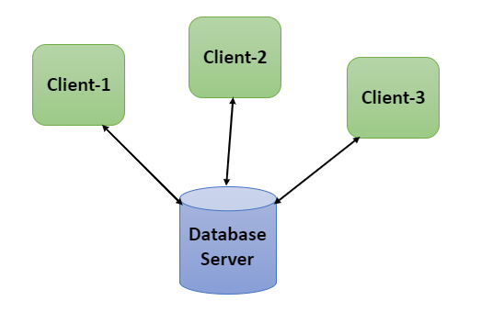
2-Tier Architecture

Slide 7
3-Tier Architecture
3-tier schema is an extension of the 2-tier architecture. 3-tier architecture has following layers:
Presentation layer (your PC, Tablet, Mobile, etc.)
Application layer (server)
Database Server
It can be used in web applications and distributed applications.
It is the most widely used architecture to design a DBMS.

Slide 8
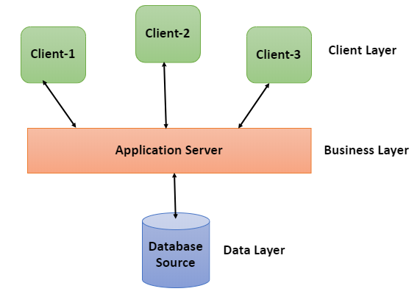
3-Tier Architecture

Slide 9

When you install a DB in your system and access it to practice SQL queries is which type of architecture?

Slide 10
When you book train ticket online follows which type of architecture?

